Slide 1
Contents of Chapter 1
1.1 Introduction
1.2 Below Your Program
1.3 Under the Covers
1.4 Performance
1.5 The Power Wall
Notes:
1.1 Introduction

Slide 2
Why Study Performance?
Helps us make intelligent design choices
  See through the marketing hype
Key to understanding underlying computer organization
  Why is some hardware faster than others for different programs?
  What factors of system performance are hardware related?
    e.g., Do we need a new machine …
    … or a new operating system?
  How does a machine’s instruction set affect its performance?

Slide 3

What do we measure?
Define performance….
Airplane Passengers Range (mi) Speed (mph)
Boeing 737-100 101 630 598
Boeing 747 470 4150 610
BAC/Sud Concorde 132 4000 1350
Douglas DC-8-50 146 8720 544
How much faster is the Concorde compared to the 747?
How much bigger is the Boeing 747 than the Douglas DC-8?
So which of these airplanes has the best performance?!
哪一种飞机的性能最好？

Slide 4
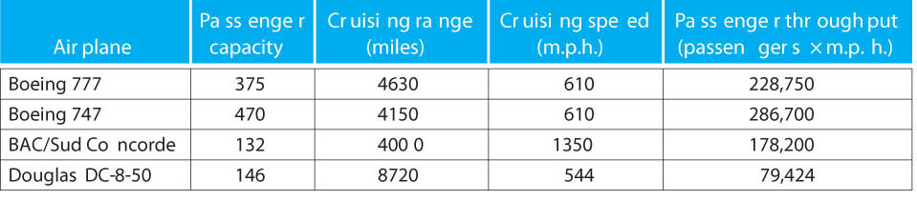

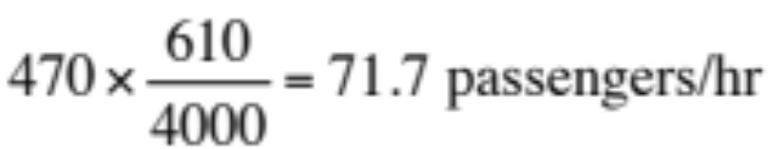
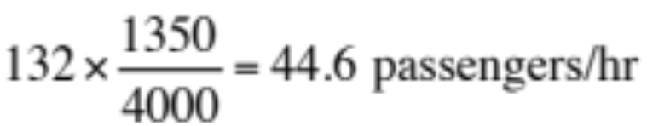
Which Airplane is “best”?
Airplane
Passenger capacity
Cruising range (miles)
Cruising speed (mph)
Passenger throughput (passengers x mph)
How much faster is the Concorde than the 747?
  2.213 X
How much larger is the 747’s capacity than the Concorde?
  3.56 X
It is roughly 4000 miles from Raleigh to Paris. What is the throughput of the 747 in passengers/hr? The Concorde?
What is the latency of the 747? The Concorde?
  6.56 hours, 2.96 hours
? 4000/610 = 6.56 hours/pass 4000/1350 = 2.96 hours/pass

Slide 5
Performance Metrics
Latency(响应时间): Clocks from input to corresponding output
  How long does it take for my program to run?
  How long must I wait after typing return for the result?
Throughput(吞吐率): How many results per clock
  How many results can be processed per second?
  What is the average execution rate of my program?
  How much work is getting done?
If we upgrade a machine with a new faster processor what do we improve?
  Latency (generally)
If we add a new machine to the lab what do we improve?
  Throughput

Slide 6
Design Tradeoffs
Maximum Performance: measured by the numbers of instructions executed per second
Minimum Cost: measured by the size of the circuit.
1
0
1
0
Best Performance/Price: measured by the ratio of performance to size. In power-sensitive applications throughput/Watt is important too.

Slide 7
Execution Time
Elapsed Time/Wall Clock Time
counts everything (disk and memory accesses, I/O , etc.)
a useful number, but often not good for comparison purposes
CPU time
Doesn’t include I/O or time spent running other programs can be broken up into system time, and user time
Our focus: user CPU time
Time spent executing actual instructions of “our” program

Slide 8
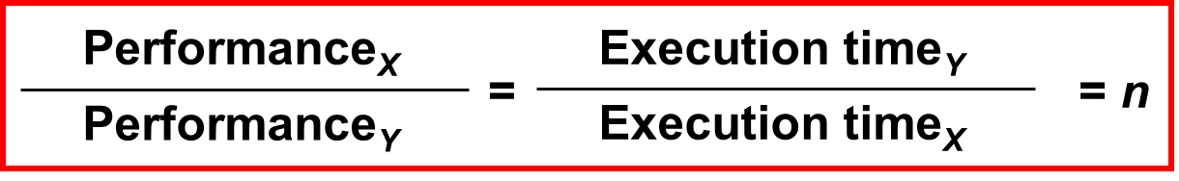
Book's Definition of Performance
Define Performance = 1/Execution Time
“X is n time faster than Y”
Problem:
Machine A runs a program in 20 seconds Machine B runs the same program in 25 seconds
Performance_{A} = 1/20 Performance_{B} = 1/25
Machine A is (1/20)/(1/25) = 1.25 times faster than Machine B
Notes:
Morgan Kaufmann Publishers
Chapter 1 — Computer Abstractions and Technology

Slide 9
CPU Clocking: Review
Operation of digital hardware governed by a constant-rate clock
Clock period
Clock (cycles)
Data transfer
and computation
Update state
Clock period: duration of a clock cycle
  e.g., 250ps = 0.25ns = 250×10^{–12}s
Clock frequency (rate): cycles per second
  e.g., 4.0GHz = 4000MHz = 4.0×10⁹Hz
Notes:
Morgan Kaufmann Publishers
Chapter 1 — Computer Abstractions and Technology

Slide 10
CPU Clocking: Review
Clock rate (clock cycles per second in MHz or GHz) is inverse of clock cycle time (clock period)
CC = 1 / CR
10 nsec clock cycle => 100 MHz clock rate
5 nsec clock cycle => 200 MHz clock rate
2 nsec clock cycle => 500 MHz clock rate
1 nsec (10⁻⁹) clock cycle => 1 GHz (10⁹) clock rate
500 psec clock cycle => 2 GHz clock rate
250 psec clock cycle => 4 GHz clock rate
200 psec clock cycle => 5 GHz clock rate
1s=10^3ms=10^6us=10^9ns=10^12ps

Slide 11
CPU Time
So, to improve performance one can either:
  reduce the number of cycles for a program, or reduce the clock cycle time, or, equivalently, increase the clock rate
Important point: changing the cycle time often changes the number of cycles required for various instructions because it means changing the hardware design.
Hardware designer must often trade off clock rate against cycle count
  Many techniques that decrease the number of clock cycles also increase the clock cycle time
Notes:
Morgan Kaufmann Publishers
Chapter 1 — Computer Abstractions and Technology

Slide 12
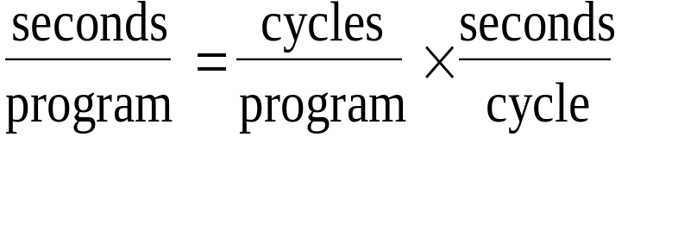

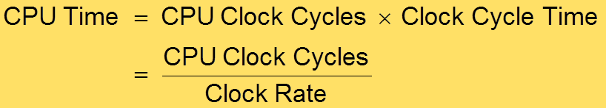
Performance Equation I
=
×
CPU execution time CPU clock cycles Clock cycle time
for a program for a program
CPU时间=CPU时钟周期数×时钟周期

Slide 13
Computer Performance Measure
Millions of Instructions per Second
Frequency in Hz
Which of these terms are ISA/Architecture dependent?
1 clocks / second
MIPS =
10⁶ AVE(clocks /instruction)
This term is canceled if the frequency is given in Megahertz (MHz)
CPI (Average Clocks Per Instruction)
时钟频率
MIPS = 10^{6*} 平均CPI
Historically:
70’s -80’s
90’s
PDP-11, VAX, Intel 8086 CPI > 1
Load/Store RISC machines
MIPS, SPARC, PowerPC, miniMIPS: CPI = 1
Your Century Modern CPUs, Pentium, Athlon, i7
CPI < 1

Slide 14
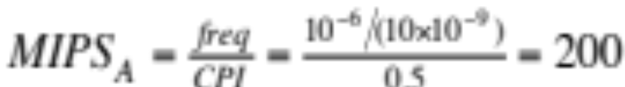
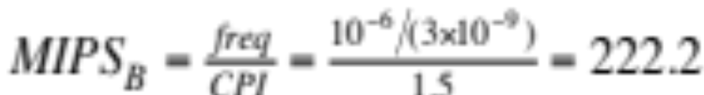
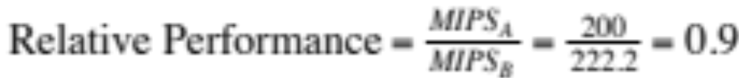
CPI Example
Suppose we have two implementations of the same instruction set architecture (ISA).
  For some program,
  Machine A has a clock cycle time of 10 ns. and a CPI of 0.5
  Machine B has a clock cycle time of 3 ns. and a CPI of 1.5
  What machine is faster for this program, and by how much?
  If two machines have the same ISA which quantity (e.g., clock rate, CPI, execution time, # of instructions, MIPS) will always be identical?

Slide 15
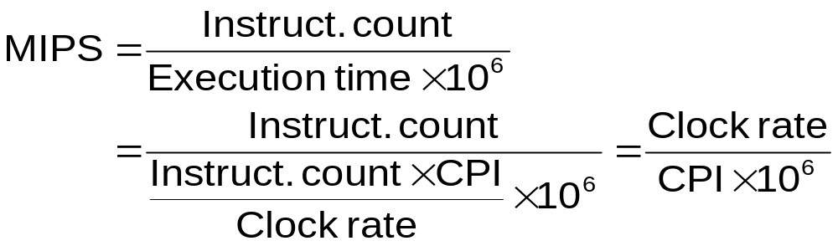
Pitfall: MIPS as a Performance Metric
MIPS: Millions of Instructions Per Second
  Doesn’t account for
    Differences in ISAs between computers
    Differences in complexity between instructions
  CPI varies between programs on a given CPU

Slide 16
小测验
某程序在2台计算机上的性能测量结果为：
测试内容 | 计算机A | 计算机B
指令数 | 100亿 | 80亿
时钟频率 | 4GHz | 4GHz
CPI | 1.0 | 1.1
1. 哪台计算机的MIPS更高？
2. 哪台计算机更快？
MIPS：Million instructions per second
百万条指令每秒

Slide 17


小测验解答
计算机A
计算机B
结论：计算机A的MIPS更高

Slide 18
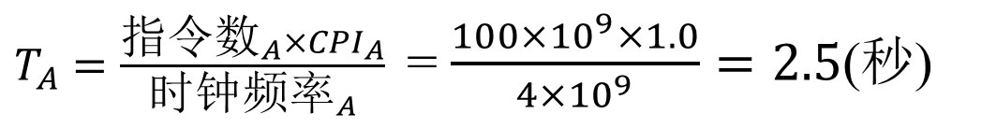
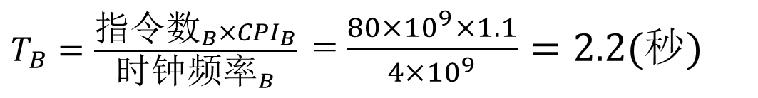
小测验解答
计算机A
计算机B
结论：计算机B更快

Slide 19
Compiler’s Performance Impact
Two different compilers are being tested for a 500 MHz machine with three different classes of instructions: Class A, Class B, and Class C, which require one, two, and three cycles (respectively). Both compilers are used to produce code for a large piece of software. The first compiler's code uses 5 million Class A instructions, 1 million Class B instructions, and 2 million Class C instructions. The second compiler's code uses 7 million Class A instructions, 1 million Class B instructions, and 1 million Class C instructions.
Which program uses fewer instructions?
  Instructions₁ = (5+1+2) x 10⁶ = 8 x 10⁶
  Instructions₂ = (7+1+1) x 10⁶ = 9 x 10⁶
Which sequence uses fewer clock cycles?
  Cycles₁ = (5(1)+1(2)+2(3)) x 10⁶ = 13 x 10⁶
  Cycles₂ = (7(1)+1(2)+1(3)) x 10⁶ = 12 x 10⁶

Slide 20
CPU performance is dependent upon three characteristics:
  clock cycle (or rate)
  clock cycles per instruction
  instruction count.
It is difficult to change one parameter in complete isolation from others because the basic technologies involved in changing each characteristic are interdependent:
  Clock cycle time —Hardware technology and organization
  CPI —Organization and instruction set architecture
  Instruction count —Instruction set architecture and compiler technology

Slide 21
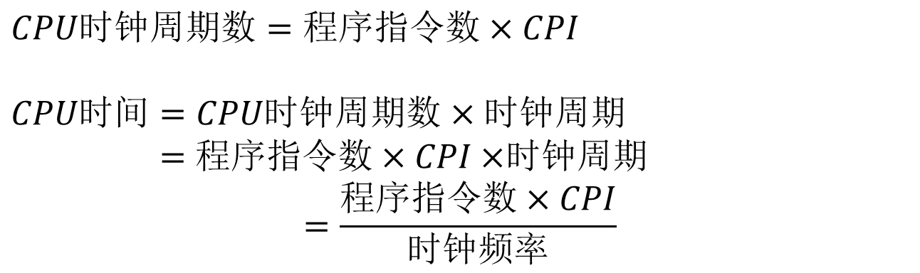
Instruction Count and CPI
CPI（Clock cycle per instruction ）
Average cycles per instruction 表示执行每条指令所需的平均时钟周期数
  Determined by CPU hardware
  If different instructions have different CPI
    Average CPI affected by instruction mix
Notes:
Morgan Kaufmann Publishers
Chapter 1 — Computer Abstractions and Technology

Slide 22
CPI Example（代码段的比较）
计算平均CPI
Alternative compiled code sequences using instructions in classes A, B, C. What is avg. CPI?
Class | A | B | C
CPI for class | 1 | 2 | 3
IC （指令数）in sequence 1 | 2 | 1 | 2
IC（指令数） in sequence 2 | 4 | 1 | 1
Sequence 1:
IC = 2+1+2=5
Clock Cycles
= 2×1 + 1×2 + 2×3
= 10
  Avg. CPI = 10/5 = 2.0
Sequence 2:
IC = 4+1+1=6
  Clock Cycles
  = 4×1 + 1×2 + 1×3
  = 9
  Avg. CPI = 9/6 = 1.5
Notes:
Morgan Kaufmann Publishers
Chapter 1 — Computer Abstractions and Technology

Slide 23

理解程序性能
编程语言
算法
指令数、CPI
指令数、CPI
指令数
CPI
时钟频率
程序
指令数、CPI
编译程序
ISA

Slide 24
Example
Our favorite program runs in 10 seconds on computer A, which has a 400 Mhz clock. We are trying to help a computer designer build a new machine B, to run this program in 6 seconds. The designer can use new (or perhaps more expensive) technology to substantially increase the clock rate, but has informed us that this increase will affect the rest of the CPU design, causing machine B to require 1.2 times as many clock cycles as machine A for the same program. What clock rate should we tell the designer to target?
cycles
⎛⎛ seconds ⎞⎞
cycles
= ⎜⎜
×
6
9
⎟⎟
= 10 × 400 × 10 = 4 × 10
program
⎝⎝ program ⎠⎠_{A}
second
cycles
cycles / program
1.2 × 4 × 10⁹
=
=
= 800 × 10⁶
second
(seconds / program)_{B}
6
Don’t panic, can easily work this out from basic principles

Slide 25
Now that We Understand Cycles
A given program will require
some number of instructions (machine instructions)
some number of cycles
some number of seconds
We have a vocabulary that relates these quantities:
cycle time (seconds per cycle) clock rate (cycles per second)
CPI (average clocks per instruction)
a floating point intensive application might have a higher CPI
MIPS (millions of instructions per second)
this would be higher for a program using simple instructions

Slide 26
Performance Traps
Actual performance is determined by the execution time of a program that you care about, not a benchmark nor a clock rate.
Variables that impact performance:
# of cycles to execute program?
# of instructions in program?
# of cycles per second?
average # of cycles per instruction? average # of instructions per second?
Common pitfall:
Thinking only one of these variables is indicative of performance when it really isn’t.

Slide 27
CPI Example
Suppose we have two implementations of the same instruction set architecture (ISA).
Like a
For some program,
Machine A has a clock cycle time of 1 ns and a CPI of 0.5 Machine B has a clock cycle time of 0.4 ns and a CPI of 1.5
What machine is faster for this program, and by how much?
1GHz i7
Like a 2.5 GHz Pentium
1 freq
1 1/(1×10⁻⁹ )
1 freq
1 1/(0.4 ×10⁻⁹ )
MIPS_{A} =
10⁶
= = 2000
CPI 10⁶ 0.5
MIPS_{B} = =
10⁶ CPI 10⁶
= 1666.66
1.5
2000
= = 1.2
Relative Performance = ^{MIPSA}
MIPS_{B}
1666.6
If two machines have the same ISA and run the same program, which quantity (e.g., clock rate, CPI, execution time, # of instructions, MIPS) will always be identical?

Slide 28
Compiler’s Performance Impact
Two different compilers are being tested for a 500 MHz machine with three different classes of instructions: Class A, Class B, and Class C, which require one, two, and three cycles (respectively). Both compilers are used to produce code for the same a large program. The first compiler's
code executes 5 million Class A instructions, 1 million Class B instructions,
and 2 million Class C instructions. The second compiler's code executes 7 million Class A instructions, 1 million Class B instructions, and 1 million Class C instructions.
Which program uses the fewest instructions?
Instructions₁ = (5+1+2) x 10⁶ = 8 x 10⁶
Instructions₂ = (7+1+1) x 10⁶ = 9 x 10⁶
Which sequence uses the fewest clock cycles?
Cycles₁ = (5(1)+1(2)+2(3)) x 10⁶ = 13 x 10⁶
Cycles₂ = (7(1)+1(2)+1(3)) x 10⁶ = 12 x 10⁶

Slide 29
Benchmarks
Performance best determined by running a real application
  Use programs typical of expected workload
  Or, typical of expected class of applications
    e.g., compilers/editors, scientific applications, graphics, etc.
Small benchmarks
  nice for architects and designers
  easy to standardize
  can be abused
SPEC (System Performance Evaluation Cooperative)
  companies have agreed on a set of real program and inputs
  can still be abused
  valuable indicator of performance (and compiler technology)

Slide 30
Workloads and Benchmarks
Benchmarks – a set of programs that form a “workload” specifically chosen to measure performance
SPEC (System Performance Evaluation Cooperative) creates standard sets of benchmarks starting with SPEC89. The latest is SPEC CPU2006 which consists of 12 integer benchmarks (CINT2006) and 17 floating-point benchmarks (CFP2006).
www.spec.org
There are also benchmark collections for power workloads (SPECpower_ssj2008), for mail workloads (SPECmail2008), for multimedia workloads (mediabench), …

Slide 31
Desktop Benchmarks
  CPU-intensive benchmarks
    SPEC89
    SPEC92
    SPEC95
    SPEC2000
    SPEC2006
  graphics-intensive benchmarks
    SPEC2000
      SPECviewperf is used for benchmarking systems supporting the OpenGL graphics library
      SPECapc
        consists of applications that make extensive use of graphics.

Slide 32
系统性能测试程序
SPEC CPU基准测试程序
SPEC - System Performance Evaluation Cooperative
SPEC CPU2006
12个整数基准测试程序集
17个浮点数基准测试程序集

Slide 33
Server Benchmarks
  SPECrate--processing rate of a multiprocessor
  (SPECSFS)--file server benchmark
  (SPECWeb)--Web server benchmark
  Transaction-processing (TP) benchmarks
  TPC benchmark—Transaction Processing Council
    TPC-A, 1985
    TPC-C, 1992,
    TPC-H→ TPC-R→TPC-W

Slide 34
Amdahl's Law
(a.k.a where to spend your efforts when improving performance)
^{t}affected
=
t
t
improved
^{r}speedup
unaffected
Example:
"Suppose a program runs in 100 seconds on a machine, where multiplies are executed 80% of the time. How much do we need to improve the speed of multiplication if we want the program to run 4 times faster?"
25 = 80/r + 20
r = 16x
How about making it 5 times faster?
20 = 80/r + 20 r = ?
Principle: Focus on making the most common case fast.
Amdahl’s Law applies to H/W and S/W!

Slide 35
Example
Suppose we enhance a machine by making all floating-point instructions run 5 times faster. If the execution time of some benchmark before the floating-point enhancement is 10 seconds, what will the speedup be if only ½ of the 10 seconds is spent executing floating-point instructions?
6 = 5/5 + 5 Relative Perf = 10/6 = 1.67 x
Marketing is looking for a benchmark to show off the new floating
-point unit described above, and wants the overall benchmark to show at least a speedup of 3. What percentage of the execution time would floating-point instructions have to be to account in order to yield our desired speedup on this benchmark?
33.33 = f/5 + (100 – f) = 100 – 4f/5 f = 83.33

Slide 36
Remember
When performance is specific to a particular program
– Total execution time is a consistent summary of performance
For a given architecture performance comes from:
  increases in clock rate (without adverse CPI affects)
  improvements in processor organization that lower CPI
  compiler enhancements that lower CPI and/or instruction count
Pitfall: Expecting improvements in one aspect of a machine’s performance to affect the total performance
You should not always believe everything you read! So read carefully!

Slide 37
Contents of Chapter 1
1.1 Introduction
1.2 Below Your Program
1.3 Under the Covers
1.4 Performance
1.5 The Power Wall
1.6 History of Computer Development
Notes:
1.1 Introduction

Slide 38
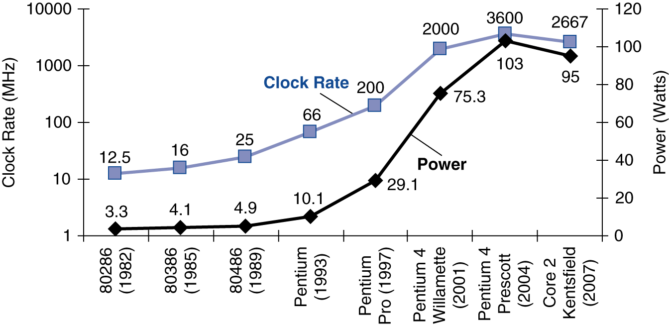
Power Trends
功耗墙
电压下降会使晶体管的漏电电流增大。
In CMOS IC technology
×30
5V → 1V
×1000
Notes:
Morgan Kaufmann Publishers
Chapter 1 — Computer Abstractions and Technology
Packaging issues for laptop and desktop PC set the “power” limit at 100 Watts.

Slide 39
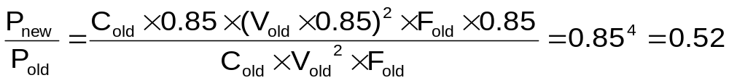
Reducing Power
Suppose a new CPU has
  85% of capacitive load of old CPU
  15% voltage and 15% frequency reduction
The power wall
  We can’t reduce voltage further
  We can’t remove more heat
How else can we improve performance?
已不能进一步减少电压了
已不能进一步改进散热了
Computer Abstractions and Technology-<number>

Slide 40
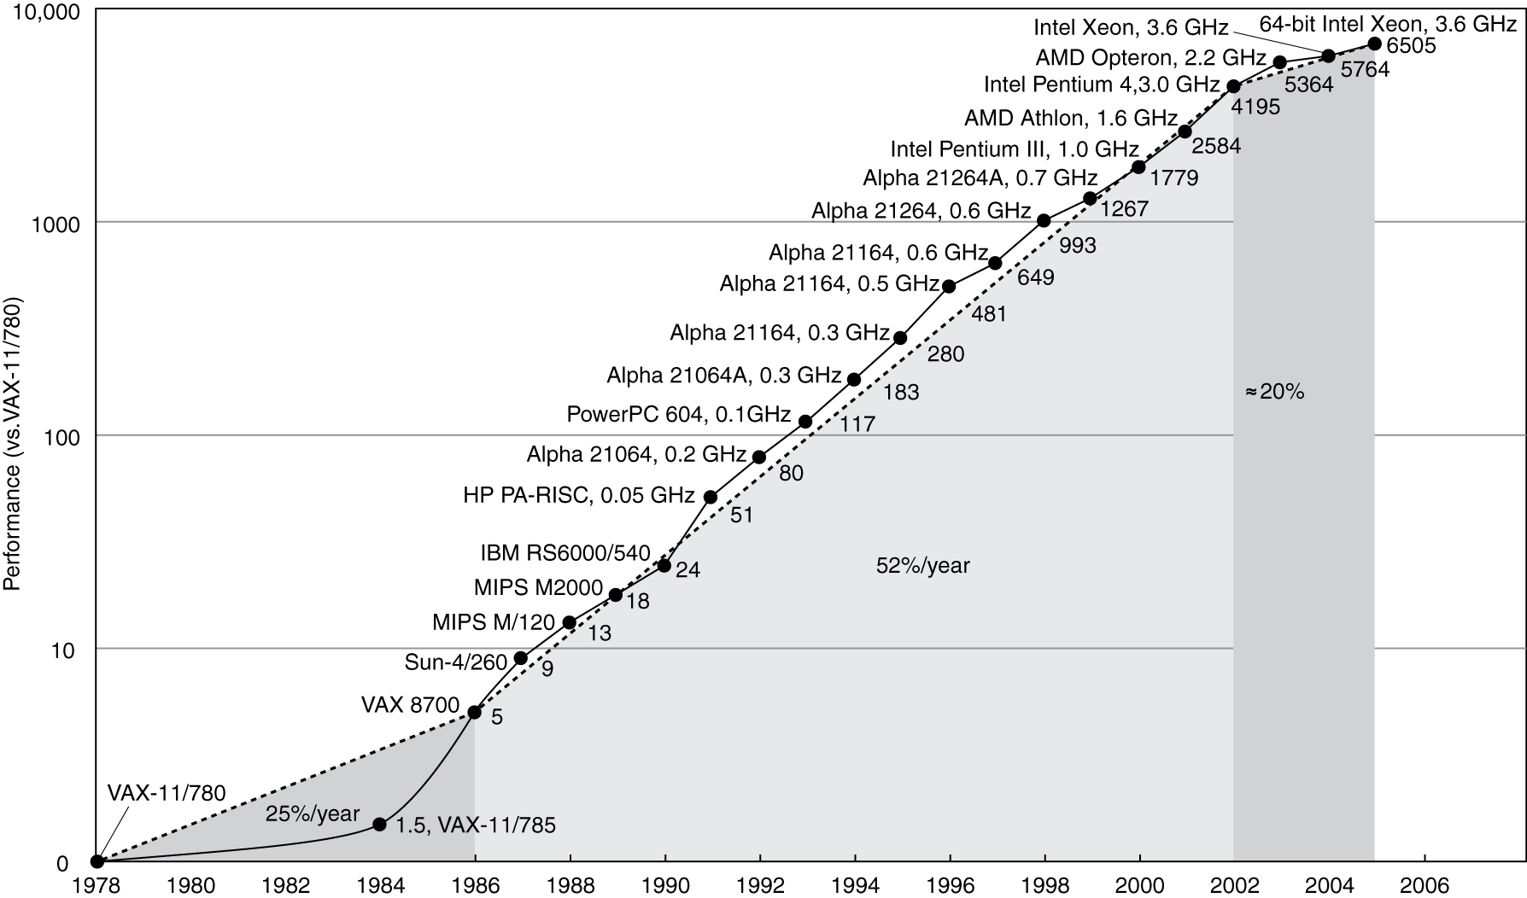
Uniprocessor Performance
(单处理器性能)
Constrained by power, instruction-level parallelism, memory latency
Notes:
Morgan Kaufmann Publishers
Chapter 1 — Computer Abstractions and Technology

Slide 41
The Sea Change
The power challenge has forced a change in the design of microprocessors
  Since 2002 the rate of improvement in the response time of programs on desktop computers has slowed from a factor of 1.5 per year to less than a factor of 1.2 per year
As of 2006 all desktop and server companies are shipping microprocessors with multiple processors – cores – per chip
Product | AMD Barcelona | Intel Nehalem | IBM Power 6 | Sun Niagara 2
Cores per chip | 4 | 4 | 2 | 8
Clock rate | 2.5 GHz | ~2.5 GHz? | 4.7 GHz | 1.4 GHz
Power | 120 W | ~100 W? | ~100 W? | 94 W
Plan of record is to double the number of cores per chip per generation (about every two years)

Slide 42
Why Multiple Cores on a Chip?
Power
Power = 1/4
Cache
4
Performance
Large Core
Performance = 1/2
3
2
2
Small
Core
1
1
1
1
C1
C2
4
4
Multi-Core:
Power efficient
Better power and thermal management
3
3
Cache
2
2
C3
C4
1
1

Slide 43
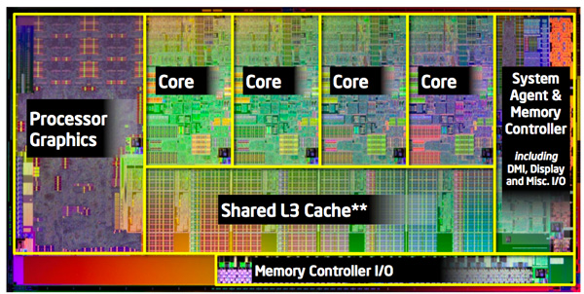
多核处理器(在一个芯片上包含多个处理器（Core）)
需要显式并行编程
指令级并行
硬件同一时刻执行多条指令
对程序员透明
面临的困难
如何编程提高性能
如何平衡负载
如何优化通信和同步

Slide 44
本章小结
硬件/软件的接口：指令集体系结构。
执行时间是唯一有效的计算机性能度量方法。
计算机组成中的2个重要思想：
程序的并行执行，典型方法是采用多处理器
开发利 用程序执行的局部性特征（Cache）

Slide 45
END
Notes:
1.1 Introduction

